Slide 1
Borrowing security from operations
Keeping the system running
through the attack

Slide 2
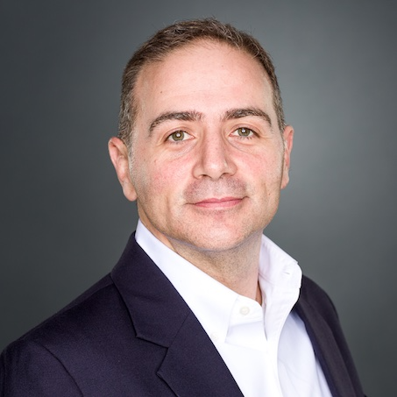
Introduction – Patrick Miller
President and CEO, Ampere Industrial Security
Former utility staff (telecommunications, water & electric)
Drafter of NERC CIP standards and formal interpretations, current SCWG, SITES, SPIDERWG contributor
First NERC CIP auditor in North America; Manager CIP Audits and Investigations (WECC)
Contributor to NERC/ERO Auditor Manual and Guidance
Speaker/contributor to multiple FERC Technical Committees, NOPRs and Orders
Former Principal Investigator US DOE National Electric Sector Cybersecurity Organization
US Coordinator, Instructor, Centro de Ciberseguridad Industrial (CCI)
EnergySec Founder, former Director, former Instructor and President Emeritus
SANS Instructor: ICS456 - Essentials for NERC Critical Infrastructure Protection
Contributor, DHS CISA Cross-Sector Cybersecurity Performance Goals (CPGs)
NTIA/INL Software Bill of Materials (SBOM) Energy POC Stakeholders
NARUC/NASEO Cybersecurity Advisory Team for State Solar (CATSS)
DOE SETO/NREL Industry Advisory Board (IAB) for the Securing Solar for the Grid (S2G)
DOE/NARUC Cybersecurity Baselines for Distribution Steering Group
GCIP, CISSP-ISSAP, SSCP, CISA, CRISC, CEH, CVI

Slide 3
Ampere Industrial Security
Pure services, specialized consulting firm
Industrial (OT/ICS) cybersecurity
Industrial physical security
Regulations, standards, and frameworks
Operations in North America, South America, Europe
We keep you ahead of your adversaries – and your auditors

Slide 4
OT is on the menu
If it’s so vulnerable, why hasn’t it been hacked before?
Ukraine changed everything
Ransomware (and similar)
Adversaries have 3 things you don’t
ICS|AP and KEV are proof
Physical threat is also on the rise
Yes, there is still some hype/FUD

Slide 5
Fragile systems set the bar
Don’t even ping it
Zero auth and otter tail
Specialized administrative software
Infini-day vulnerabilities
Patching: now, next, never
Latency matters
Flat networks
Designed for long life span

Slide 6
Mythical OT protections
Airgaps
Serial
Obscurity
Proprietary
Age
Complexity
Redundancy
Engineer experience

Slide 7
IT to the rescue!
Step away from the SCADAs… IT is here to save the day!
Why can’t we use NMAP?
Have you tried turning it off and back on again?
Is this Windows XP?
Yeet it to production!
It doesn’t speak IP?
Where is your neckbeard?

Slide 8
Mechanical Operations
Predictive maintenance
Sensing and monitoring
Analytics
Automation
Enhance efficiency and consistency
Scalability
Quality assurance
Expected level of quality
Samples and measures

Slide 9
Maintenance Operations
Preventive maintenance
Asset management
Scheduled inspections and calibration
Threat hunting
Root cause analysis
Analyze failures
Lessons learned
Logging and auditing
Spare parts management
Availability of essential parts
Redundancy, HA (where possible)

Slide 10
Support operations
Supply Chain Management
SDLC
SBOM, HBOM, FBOM
Made in (assembled in)
Customer Support
Internal parties
External parties
Vendor Management
Risk assessments
Availability, timeliness, consistency

Slide 11
Technical Operations
Technology Adoption
Disruption
Divergence from legacy
Skills and training
Configuration Management
System and network baselines
Testing
Data Management
Everything has a data stream
Cloud, analytics, feedback loop

Slide 12
Safety
Safety Protocols
Safe operating procedures
Hazard notice, inspection and operations
Personal Protective Equipment (PPE)
Transient cyber assets
Removable media
Known-safe software
Safety Training
Communication, culture
Training/certification prior to use

Slide 13
Regulation
Audits and Inspections
Go/no-go decisions
Penalties and sanctions
What is required vs. desired
Automation vs. manual
External Review
Other governance bodies
Insurance
M&A activity
Shareholders, market, competitors

Slide 14
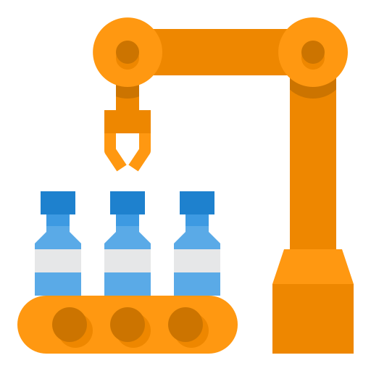
The new normal

Slide 15
Engineering vs. security
Mother nature may be harsh but she’s not malicious
Physics
Malice
Different motivations
Protect the people from the machines
Protect the machines from the people
Cyber Informed Engineering
Analog AND digital controls
Process-focused for resilience

Slide 16
Translation exercise
Culture shift is necessary – for both
Egos, respect, indifference
Necessary symbiosis
Interdependencies
Incidents usually start in IT
Common technologies and skills
ITSMF <> OTSMF
Criticality and diligence
Regulation is getting smart

Slide 17
There’s no “I” or “O” in TEAM
Org structures & job shadowing
Business Impact Assessment (BIA)
SOC analysis & thrunting
Incident response
Backup/recovery
Resilience
Dependency analysis
Islanding
Regulatory compliance

Slide 18
CONTACT
Patrick C. Miller – CEO, Ampere Industrial Security
pmiller@amperesec.com
https://www.linkedin.com/in/millerpatrickc/
@patrickcmiller@infosec.exchange
@patrickcmiller.bsky.social
@patrickcmiller
+15032721414
All images sourced from https://www.flaticon.com/

